Slide 1
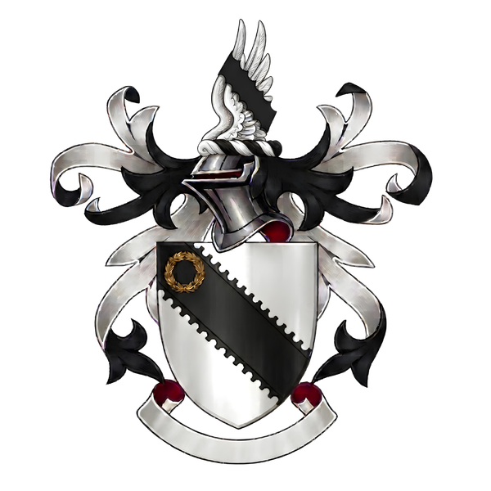
Brydges
of Old Colwall in the County of Hereford
GEN I
William Bridge = Margaret Vaughan
b. 1584, per the printed pedigrees · bur. Bosbury 14 Aug 1627 · Margaret d. 14 Apr 1655, aged 80
William
bapt. 1601 · d. 1668
John
James
bapt. 4 Sep 1606
GEN II
Richard
bapt. 9 Nov 1617
Mary
Jane = John Ridley
Margaret
bapt. 16 Apr 1615
Thomas Brydges = Joan Hill
bapt. 24 Jun 1610 · d. 6 Apr, bur. 9 Apr 1692
Elizabeth = Dr Bridstock Harford
GEN III
Anne = R. Browne
William = Ursula Drew
bapt. 13 Sep 1640, son of Thomas & Joan per the register · d. 23 Jul, bur. 27 Jul 1704
John
1671 – 1742
GEN IV
Thomas
Richard
William = Elizabeth Dalton
William Brydges = … Wootton
Elizabeth = Harford Jones
m. 1730
GEN V
Richard
d. 18 Dec 1758, aged 58
John
Elizabeth
d. unm. 1806/7
Mary
d. 1826
Thomas = Sarah King
d. 9 Jul 1765, aged 61
Thomas Brydges = Eliz. Needham
GEN VI
Margaret = John Wilson
George
Mary Anne
Richard = Elizabeth Prattington
b. c. 1755 · m. c. 1773 · bur. Colwall 29 Jan 1813, aged 58
Ann
bapt. 11 Jul 1774
Maria
bapt. 5 Oct 1775
GEN VII
Richard Francis William
bapt. 8 Sep 1776
Thomas
bapt. 24 Oct 1778 · bur. 30 Apr 1827
Edward
bapt. 22 Feb 1782 · bur. 26 Oct 1829
Dr William Henry = Alice Halford
b. 1 Dec · bapt. 12 Dec 1779, Colwall · bur. there 19 Mar 1863, aged 83
Henry
b. c. 1825
GEN VIII
Ann
b. c. 1826
Joseph Halford = Catherine Morton
b. 27 May 1807, Ledbury · d. 28 May 1874, Middlesex · Catherine 1811 – 1847
GEN IX
Joseph = Rebacca Corrock
b. 1842, Southwark · d. Apr 1886, Poplar · Rebacca b. 1843
Louisa
b. c. 1869, Bethnal Green
Henry W Brydges
b. 1876
GEN X
Florence
b. c. 1878
William
b. c. 1880, Old Ford
William Charles = Annie L Knapp
b. 14 Oct 1881, Somers Town · birth reg. Pancras, Q4 1881 · d. 19 Feb 1967, Leamington · Annie 1881 – 1928
Annie Louisa
b. c. 1903
William Charles
b. c. 1905
GEN XI
Lily Hannah
b. c. 1909
Violet Mary
b. c. Nov 1910
John James = Annie L Edwards
b. 19 Mar 1907 · d. 1977 · Annie b. 6 Oct 1913 · d. 1993
John
Brian
Alec
GEN XII
Rosemary
Mary
Charlie
Ann = Alan William Randall
Ann 1937 – 2014 · Alan b. 1936
The line continues

